Slide 1

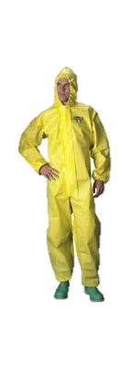



International Perspective/Future on Garment Standards and Glove Research
Research Foundation
The Pesticide Stewardship Alliance Conference
Mobile, Alabama 2013
Carol Black, NASDA Research Foundation

Slide 2
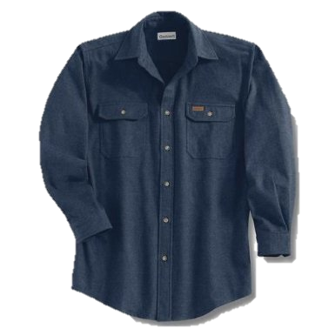

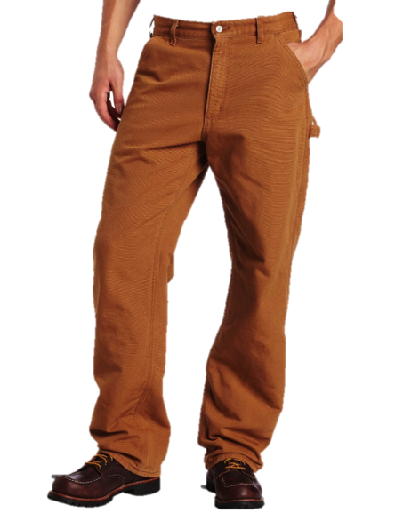

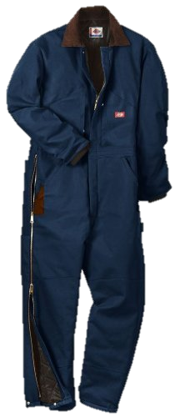

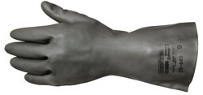
Garments
and
Gloves
Protection from Dermal
Exposure
Notes:
The next slide will ask about the types of gloves Materials you use. These are the glove types noted on many pesticide labels. Review by each name.

Slide 3
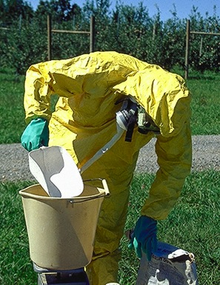
US Pesticide Label
pesticidepics.org
Risk Assessment
  Toxicity
  Formulation
  Use pattern
  Dermal exposure
  Inhalation exposure
  Closed-mixing systems
Cannot imagine this much protection would EVER BE warranted, and doubly doubtful being a solid formulation
Notes:
The Pesticide Label and the PPE statements are based on a risk assessment conducted by the manufacturers and EPA The risk assessment changes based on the toxicity of the product, the formulation, how and where the product is used, the potential for dermal or inhalation exposures and whether closed-mixing systems are used
The image to the right indicates the person is extremely concerned about exposure – respirator, Tyvek-like suite, gloves – yet they are handling solids that would never require this level of protection. This is a common problem with PPE education, outreach and training sources. We seem to use the “shock” factor and not couch the training in reality.
In fact, EPA and the pesticide manufacturers make all sorts of adjustments to the concentration of the product, rate applied, exposure scenarios to avoid high-level requirements for PPE. Both EPA and the manufacturers are well aware of the concern for heat stress and do not want over-protection to lead to other health implications. The label as you will see with this presentation has a variety of PPE requirements that are used to mitigate the risks of that particular formulated product.

Slide 4
US Environmental Protection Agency
Acute Toxicity Risk versus Other Risks

Slide 5
EPA Matrix for PPE: Dermal & Inhalation Toxicity
Other factors, in addition to default acute toxicity values, are used.
Type of PPE | Certification Requirements* (Not in EPA matrix) | Minimum Required | Next Highest Level of Protection | Next Highest Level of Protection | Highest Level of Protection
Protective Clothing | None | Long-sleeved shirt and long pants | Coveralls over short-sleeved shirt and short pants | Coveralls over long-sleeved shirt and long pants | Chemical- resistant suit
Protective Footwear | None | Socks and Shoes | Chemical-resistant footwear | Chemical-resistant footwear | NA
Gloves | None | None | Chemical-resistant gloves | NA | NA
Protective Headwear | None | None | Chemical-resistant headgear | NA | NA
Chemical Resistant Apron | None | None | Chemical-resistant apron worn over coveralls over short-sleeved shirt and short pants | Chemical-resistant apron worn over coveralls over long-sleeved shirt and long pants | NA
Respiratory Protection Device | NIOSH Certified | None | Particulate filtering respirator: NIOSH approval number prefix (TC-21C) or a NIOSH approved respirator with any R,P, or HE filter | A respirator with an organic-vapor removing cartridge with a prefilter approved for pesticides | Air Supplying Respirator
Notes:
This is the foundation matrix that EPA currently uses to assign personal protective equipment statements. At this time only respiratory equipment is certified by an outside agency. This is the basic structure for PPE language found on labels. From no PPE, to more, and more.

Slide 6
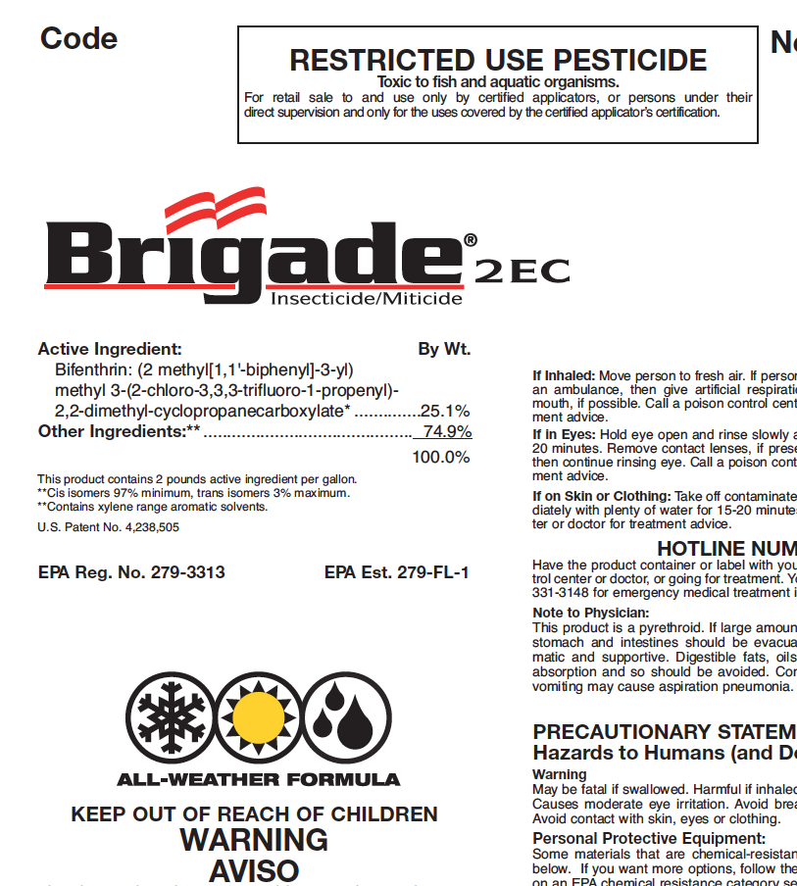
PPE for Applicators (dilute/conc.)
Some materials that are chemical resistant to this product
are made of any waterproof material. If you want more
options, follow the instructions for Category E on an
EPA chemical resistant chart
Long-sleeved shirt and long pants
Chemical resistant gloves, such as
Barrier Laminate or Nitrile Rubber
or Neoprene Rubber or Viton
Shoes plus socks
Protective eyewear
Bifenthrin
Notes:
Heat concern

Slide 7
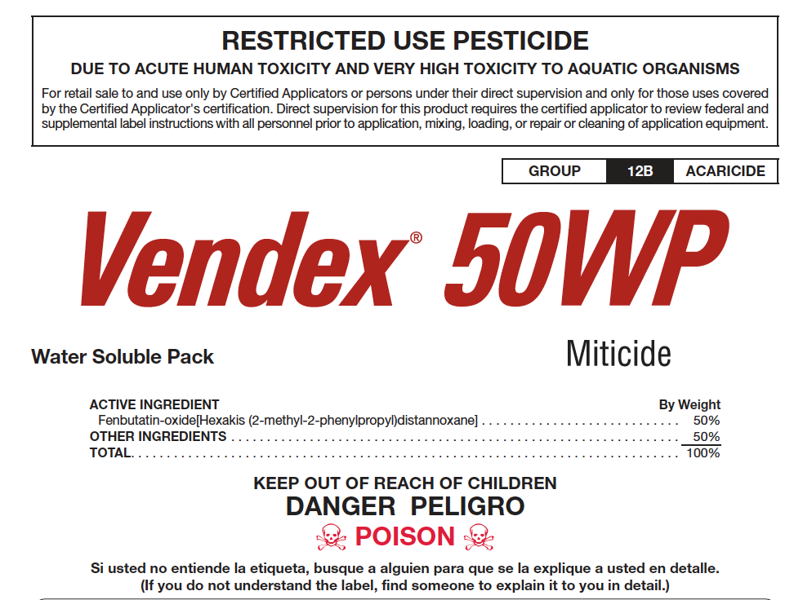
PPE for Applicators (air/ground)
Coveralls over short-sleeved shirt and short pants
Socks and chemical-resistant shoes
Chemical resistant gloves (Category A)
Protective eyewear (goggles, face
shield, or safety glasses)
Chemical-resistant headgear
NIOSH approved respirator with any R, P, HE filter
For cleaning equipment, add a chemical-resistant apron
Apply when mites first appear and when daily temperature is expected to exceed 21.1°C
Fenbutatin-oxide
A = basically waterproof

Slide 8
PPE for Applicators (ground)
Materials that are chemical resistant to this product
are barrier laminate and viton.
Coveralls over short-sleeved shirt and short pants
Chemical-resistant footwear plus socks
Chemical resistant gloves
Chemical-resistant headgear for
overhead exposure.
A NIOSH-approved respirator dust-mist filtering respirator with MSHA/NIOSH approval number TC-21C or a NIOSH-approved respirator with any N, P, R, or HE filter.
Lorsban 4E
Warning
Revised 2012

Slide 9
Protective Clothing in the US
Clothing label language is based on garment type
and layers of garments
  not any scientific garment/fabric standard, garment quality
  or efficiency
Fabric performance varies considerably
  Performance depends on the material and the finish applied to the fabric – garments worn are not tested for similarity to those used in exposure studies
  Data show that a pant/shirt can have much better protection than some coveralls – seams and closures may play a significant role
New ASTM and ISO performance-based standards for fabrics/finishes are in place
  Scientists are conducting wear studies prior to implementation
  in the US
  Used in Europe and Brazil
Notes:
Currently EPA and chemical manufacturers use LAYERS of garments for protection, not the garment type. In the US, there is currently NO standard for the term “chemical resistant garment”. EPA and the manufacturers recognize the great concern that wearing extra garments and garments that don’t breathe can add to heat stress concerns.
The problem is with no garment standards, the different fabrics, or fabric finishes vary considerable and that a basic pant and shirt can provide better protection than some coveralls
The good, recent news is that the American Society of Testing and Materials as well as the ISO International Standards no do have standards for garment quality. Dr. Shaw is working with EPA, garment manufacturers, chemical industry, and other researchers to pursue the adoption of the new standards for protective equipment for pesticide applicators in the United States. Stay tunes for improvements in this area.

Slide 10
ASTM International Standard F2669-09
Standard Performance Specification for Protective Clothing Worn by Operators Applying Pesticides
Based on field strength using liquid form
  liquid penetration resistance, resistance to penetration by liquid under pressure, resistance to permeation, breaking strength, and tearing strength
Minimum performance: material, seam, and garment requirements
Sets Garment Classification
Sets Labeling Requirements
Includes: liquid-tight or spray-tight garments, coveralls, jackets, shirts, and pants
Excludes garments used to protect the head, hands, and feet
Excludes biocides, fumigants, or highly volatile liquids
Approved garments shall be supplied with permanent labels and sheets detailing instructions for use, product technical information, and chemical-resistance information.

Slide 11


ISO 27065:2011 Protective Clothing – Performance requirements for protective clothing worn by operators applying liquid pesticides.
Benchmarks for performance requirements
Both standards-development organizations published the same technical requirements.
In Brazil, the ISO standard is used for
garment certification
  30 companies manufacturing cotton and
  cotton/polyester garments with repellent finish
  that are certified as Level 2 garments in Brazil
European Committee for Standards (CEN)
adopted the ISO standard as European
Norm (EN) rather than to develop a separate
European standard

Slide 12
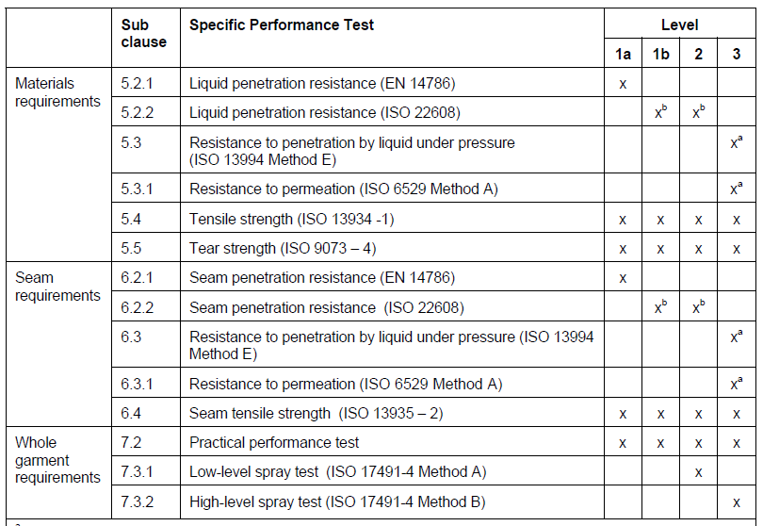
ISO - Testing Requirements for Level 1, 2 and 3 Garments

Slide 13
Level of Protection
Protection increasing
Level of protection | NO PPE MWCS | 1 |  | 2 | 3
 |  | 1a | 1b |  | 3a
Material | Long sleeved shirt and trousers Work clothing | Porous Poly./cotton or cotton |  | Porous Poly./cotton or cotton with water repellent finish Spray tight garments | Liquid tight impervious garments
Proposed exposure reduction factor | 0.1 | 0.05 |  | 0.01 | 0.002

Slide 14
What levels 1, 2 and 3 mean in practice?
No PPE: normal work clothing
PPE Level 1: porous breathable garments made from cotton or polyester/cotton, woven, twill (as used in most industry operator exposure studies)
PPE Level 2: porous breathable garments made from cotton or polyester/cotton with water repellent finish, but also single use garments similar to the European chemical protective clothing type 4 (spray tight).
PPE Level 3: impervious coveralls like the European chemical protective clothing type 3 (liquid tight).

Slide 15
Pesticide Labeling for Garments
Brazil – must wear certified Level 2 garment
→ Level 3
US – minimum long sleeved shirt, long pant → then another layer of clothing – no garment standard
Europe varies
  “wear protective clothing”
  PPE clothing be certified, but not EN standard to certify clothing for pesticide operators
  Certified Type 6 and Type 4 typically used for protection

Slide 16
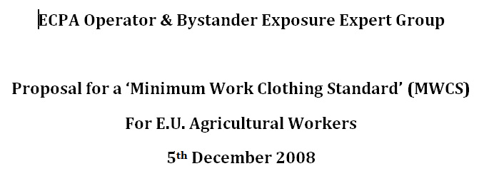
A minimum clothing standard proposed for all European member states is:
Long-sleeved cotton or cotton polyester shirt and long cotton or cotton polyester trousers or an all in one cotton or cotton polyester coverall;
Socks and sturdy footwear.
All registered product labels would be required to prominently display the above description as a recommendation for use of products that do not require additional personal protective equipment during mixing, loading and application, such as an ISO/CEN/DIN certified, i.e. protective coverall, gloves and respirators.

Slide 17
Next Steps for EU
The standard ISO 27065 is available, but
not mandatory for ISO countries.
PPP Label: It is proposed to determine the
level of protection by a risk assessment and
to indicate it on the label.
In the US a consortium is in discussion to bring together global efforts regarding PPE recommendations. The question is whether CLI/CL regions are interested to join the consortium?

Slide 18
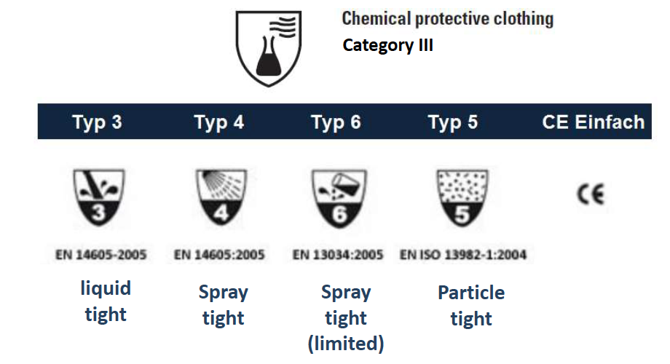
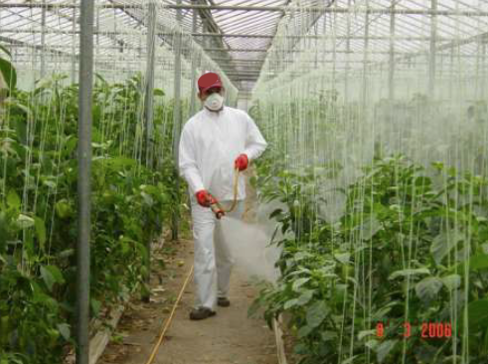
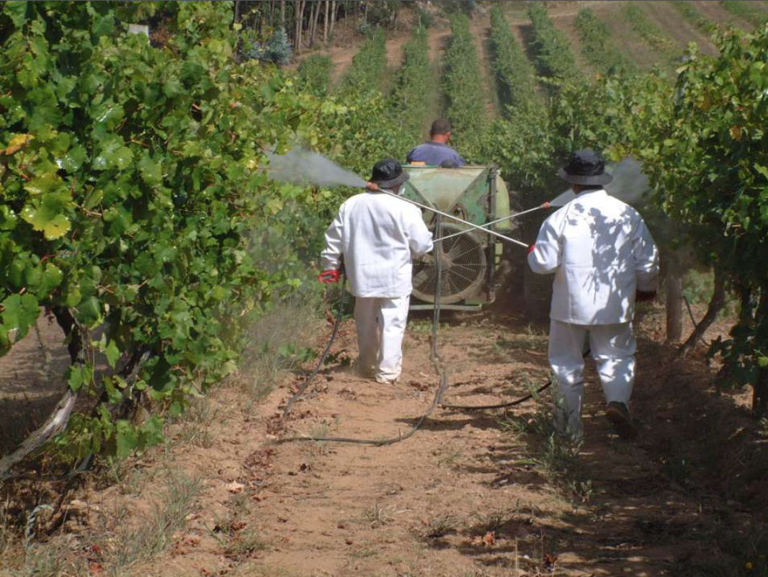
Protective Clothing in Europe (CE)
Impermeable
ISO Level 3

Slide 19
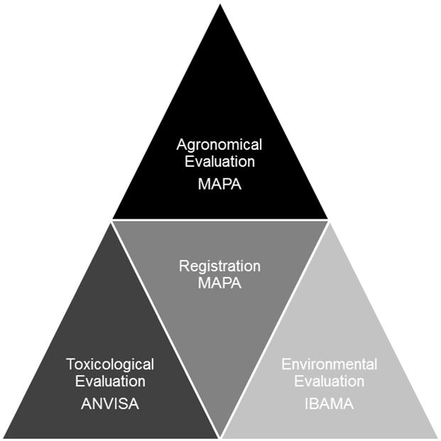
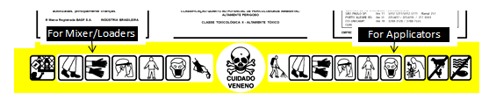
Brazil Garment Requirements
ISO 27065 Level 2 and/or Level 3 garments
  available on QUEPIA website http://www.quepia.org.br/site/afiliadas.php
  approved garments are posted on the QUEPIA website

Slide 20
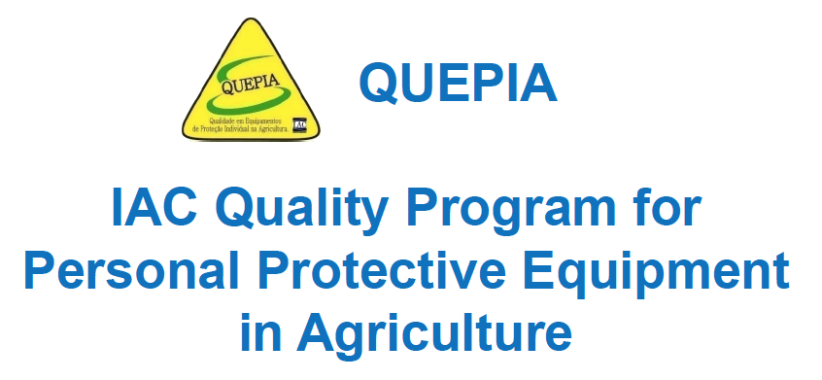
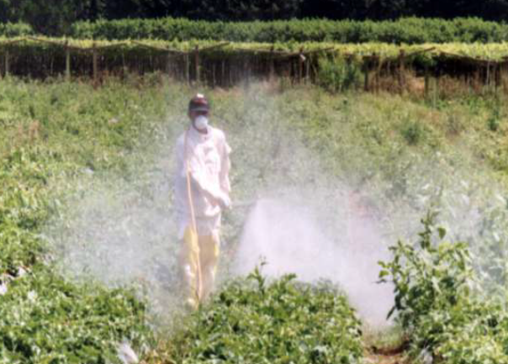
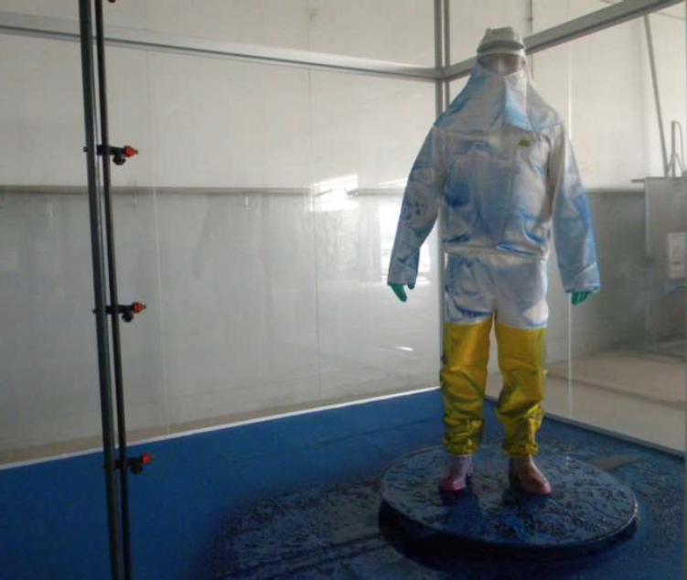
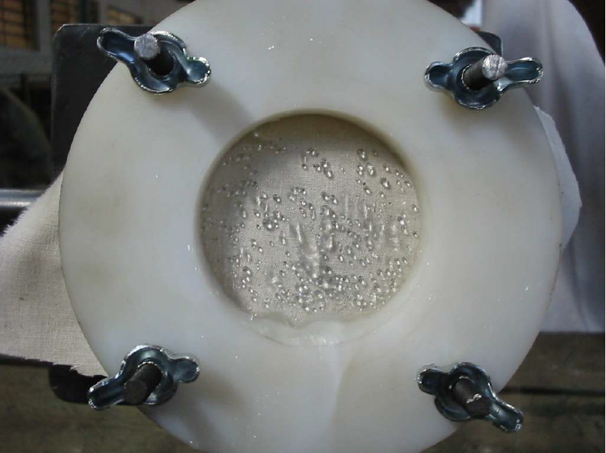
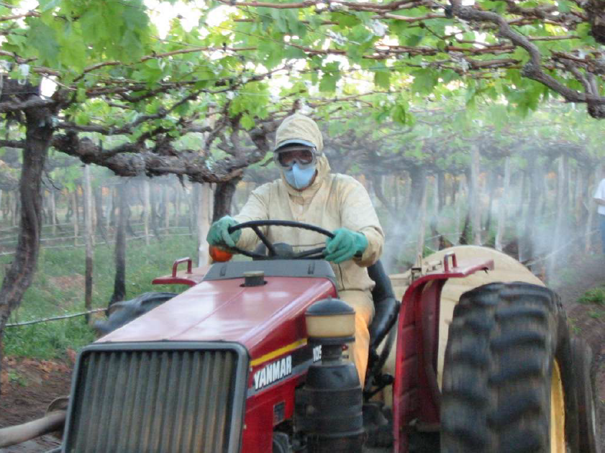
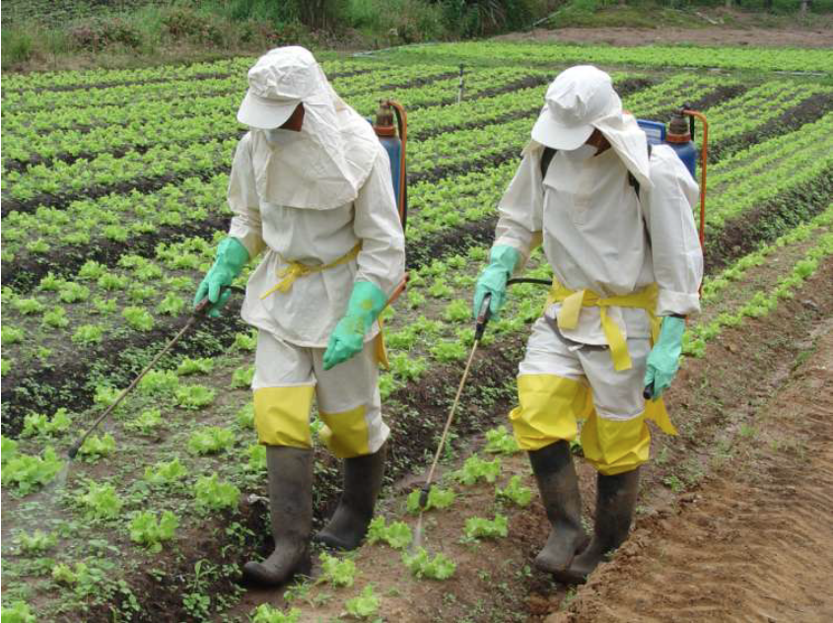
Protective Clothing in Brazil

Slide 21
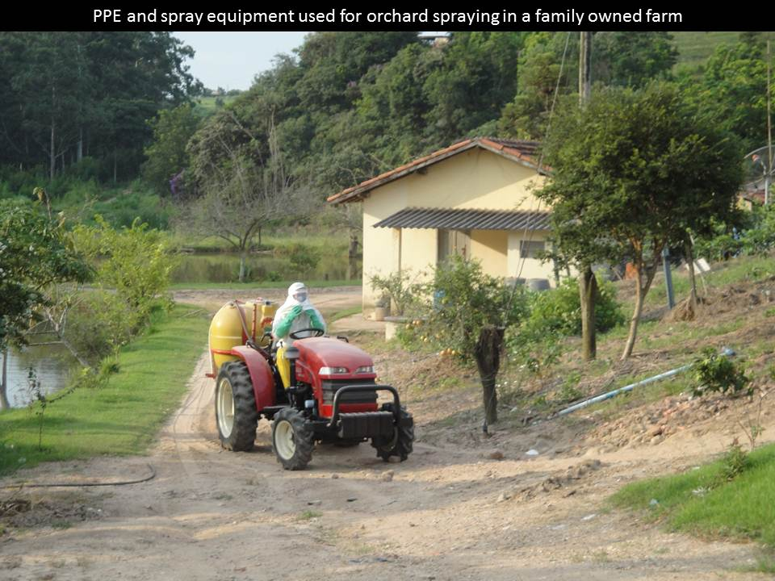

Slide 22

Japanese Standard under consideration

Slide 23


India and China entering into the discussion

Slide 24

CropLife International
Minimum requirement:
clothing covering most of the body, which includes:
  long sleeve upper garment,
  a garment covering the lower body including the legs,
  footwear (boots or shoes)
  if spraying high crops, a hat.
Where possible choose clothing made of the thicker/heavier material that is durable and also comfortable enough to wear for a working day.

Slide 25

Global PPE Consortium
Harmonized approach for
garments and gloves
  Risk Assessment (protection
  factors, exposure studies)
  Garment and glove classification
  Clear, consistent label language
Recognize similar terms that trigger operator protections
  MOE – Margin of Exposure (US)
  AOEL – Acceptable Operator Exposure Level (EU)

Slide 26
Global PPE Consortium
Exposure Studies Done Independently in 1980’s and 1990’s
  PHED – Pesticide Handler Exposure Database (US, Canada)
  POEM – UK
  German Model
  Dutch Model
More recent activity
  AHED – Ag Handler Exposure Database (proprietary)
  EUROPEM – replace POEM and German model
  ECPA greenhouse model
  EFSA combination model
  Newer 2013 model combines Bfr-Germany, CRD-UK, ANSES-France, EFSA, TNO-Netherlands, and ECPA
  ANDEF-Brazil working with US
  US is working with Chinese
Significant model variation for estimating operator exposure
  Greenhouse study comparison – realized 0.4% transmission to skin when models showed 2.3%-20%
Notes:
European Crop Protection Assn
European Food Safety Authority

Slide 27
Assigned Protection Factors (PF)
Tool to calculate risk reduction provided by PPE
No consensus per type of garment
Exposure calculations have different results
 | US | EU-German | EU –UK-POEM
Single Layer Clothing | Use dosimeter findings -if not available, use 0.5 (50%) PF | 95% reduction – 0.05 PF | 98-80% reduction – 0.02 – 0.20 PF
Double Layer Clothing | 75% reduction – 0.25 PF
Chemical Resistant Gloves | 90% reduction – 0.10 PF | 99% reduction – 0.01 PF | 99-90% reduction – 0.01-0.10 PF

Slide 28
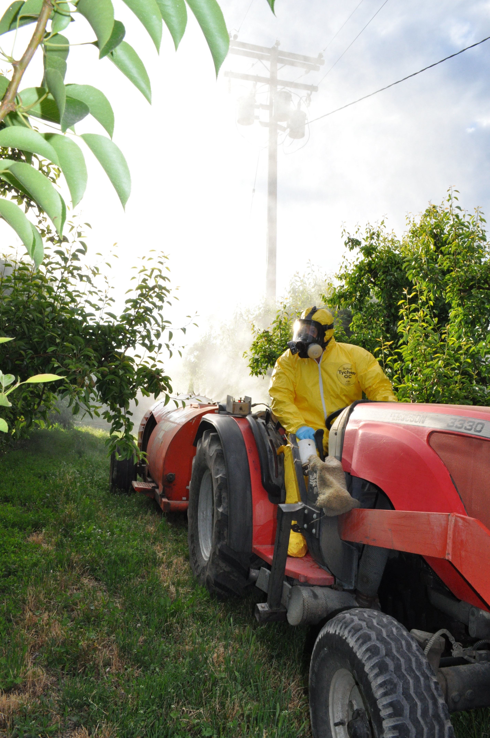
US Process to Assign PPE
Interim PPE based on acute toxicity
Estimate occupational risk based on MOE and uncertainty/safety factors
Conduct Handler assessment
  Calculate MOE
  Estimate occupational exposure with no PPE
  Use PPE protection factors to achieve MOE
Develop PPE requirements that meet Worker Protection Standards
Gery Amos

Slide 29
European Union Process
Assign PPE based on
hazard identification based
on all ingredients
Assign PPE based on risk assessment
  Estimate occupational exposure with no PPE
  Compare estimated exposure levels to AOEL with no PPE
  Use PPE protection factors to achieve AOEL
Develop PPE requirements based on above

Slide 30

Brazil – no process
No risk assessment process is being used
The same PPE is required for all products
2011 publication by ANVISA for public consultation to establish new legislation with the intent to change the
decision-making process
from hazard-based to
risk-based
Still under revision
A trigger for the Brazil
Symposium

Slide 31
Barrier Laminate
PVC
polyvinylchloride
Gloves
Gloves
Gloves
Polyethylene
Viton
Nitrile
Butyl Rubber
Neoprene
Notes:
The next slide will ask about the types of gloves Materials you use. These are the glove types noted on many pesticide labels. Review by each name.

Slide 32
Pesticide Labeling for Gloves
Brazil – chemical-resistant gloves required – no standard
US – minimum no gloves → Chemical Resistant Chart (for gloves)
  Chart has 8 types of materials and three levels of protection (plus NONE)
  Chart is based on breakthrough time of solvent, no certification of glove
Europe varies
  Type of glove material and breakthrough time must be specified (EN374:2003)
  Breakthrough time is typically reported for solvents

Slide 33
Only Gloves Rated ‘High’ Are Selected for Labels
EPA Chemical Resistant GLOVE Chart -- as noted for all-day tasks
Solvent Category | Barrier Laminate | Butyl Rubber ≥ 14 mils | Nitrile Rubber ≥ 14 mils | Neoprene ≥ 14 mils | Natural Rubber ≥ 14 mils* | Poly-ethylene | Polyvinyl Chloride (PVC) ≥ 14 mils | Viton ≥ 14 mils
A (dry and water- based) | High | High | High | High | High | High | High | High
B | High | High | Slight | Slight | None | Slight | Slight | Slight
C | High | High | High | High | Moderate | Moderate | High | High
D | High | High | Moderate | Moderate | None | None | None | Slight
E | High | Slight | High | High | Slight | None | Moderate | High
F | High | High | High | Moderate | Slight | None | Slight | High
G | High | Slight | Slight | Slight | None | None | None | High
H | High | Slight | Slight | Slight | None | None | None | High
Notes:
Only 15 mil gloves were tested – except for polyethylene
Labels do not state thickness
So the glove research is part of EPA’s label review manual. This is known as the Chemical Resistant Chart. It only relates to gloves and the categories with HIGH noted are for appropriate gloves for all-day tasks. As you can see the glove types in the top row are the ones that Dr. Little found to be protective for certain solvents.
However, note the thickness of some of the gloves are noted to be less than or greater than 14 millimeters thick. This is the only glove thickness tested. For barrier laminate and polyethelene (food handling) gloves, there was not minimum thickness noted. Those polyethelene gloves are good for water-soluble and dry products!
As you can see all gloves are suitable for dry or water-based formulations– the first row of the chart. But after that row, only some glove types are appropriate for certain solvent-based formulations. Note for G and H that only two glove types are appropriate and one costs about $6, while the other is over $70.

Slide 34
Glove Statements – Insecticide Examples
Brigade (2008)
  Wear chemical resistant gloves, such as Barrier Laminate, Nitrile Rubber, or Neoprene Rubber, or Viton
Sevin 4F (2010)
  Some materials that are chemical resistant to this product are made of any waterproof material. . . . For more options, follow instructions for Category A on an EPA Chemical Resistance Chart. . . . Wear chemical resistant gloves.
Lorsban Advance (2012)
  Materials that are chemical resistant to this product are barrier laminate or viton >14mils . . . . Must wear chemical resistant gloves.
Notes:
So for insecticides
Brigade – fairly straight forward, but since they use the term “Such As” does that mean others might do? In reality the reason it says “such as” is the person writing the label copied the term form the label review manual for the types of gloves they were supposed to add – It should read. Wear --- and name the glove type.
You will find this misuse of the term such as on almost ALL labels.
For the Sevin label again, it notes waterproof and if you want to know the ones from the chart, the chart letter. No too bad.
For Lorsban – very clear!

Slide 35
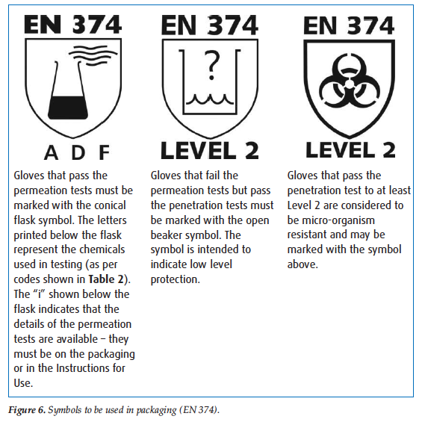
EU Glove Guidance

Slide 36
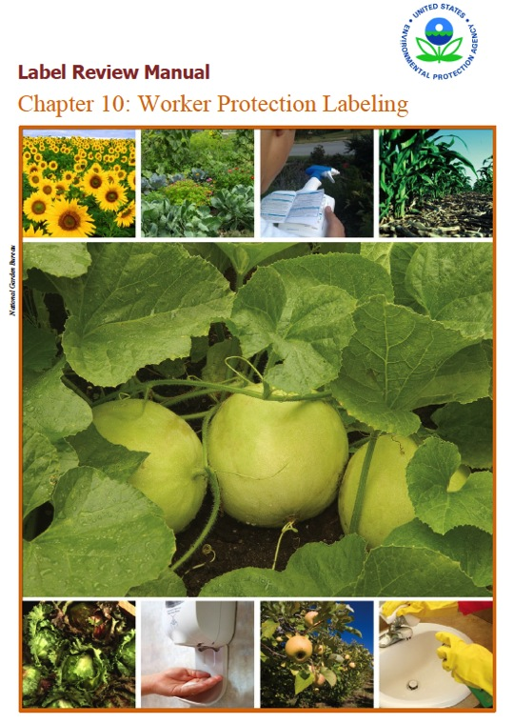
Dr. Anugrah Shaw – Univ. of Maryland Eastern Shore
No aggregate data was available to determine the scope of the PPE challenges
Label review manual is fairly prescriptive for PPE language
What is really being required
Notes:
Dr. Shaw reviewed the scientific literature and found there really was no published information about the most significant challenges are related to PPE use for pesticide applicators. All of the infomormation was really anecdotal stories of challenges, like inconsistent label language, finding the right PPE in the marketplace, issues with decontamination, and more and more stories.
Dr. Shaw then looked harder for information on the label language assigned for different pesticide products and the key source is EPA’s Label Review manual and EPA’s fundamental risk assessment of toxicity, formulation, and use patterns.

Slide 37
from Dr. Anugrah Shaw, UMES
1868 labels analyzed from CDMS in 2012
Notes:
Again 1868 labels were scrutinized.
140 had NO requirements for gloves!!! The risk assessment noted there was not concern for dermal exposure!
Surprise, surprise.
Then 2 labels, just said gloves
174 labels stated waterproof, but did not stipulate any particular glove type.
They lion’s share of labels, 83% of them, noted chemical resistant gloves.
Those gloves then provided a little more detail on the glove type – which is what the label review manual says is required.
On the far right of the graph – you can see that 341 stated chemical resistant, but did not say which gloves. So the question becomes, will any glove do?
Then of the 1552 labels requiring chemical resistant gloves, 648 say category A, which means waterproof. So in reality you have the 174 from the top chart and the 648 from the bottom chart with makes of over 50% of pesticide labels requiring waterproof gloves.
Then you can see that other labels vary in the solvents and their glove requirements.

Slide 38
Approximately, how many times do you handle pesticides (herbicides, insecticides, fungicides, etc.) in a year?
Do you wear gloves when handling pesticides? (herbicides, insecticides, fungicides, etc.) (multiple choice)
Audience Response Presentation
Carol Black, WSU
John Stone, MSU
Dec 2012 and Jan 2013

Slide 39
How many different glove materials do you wear during a year?
What glove material do you wear most often?

Slide 40
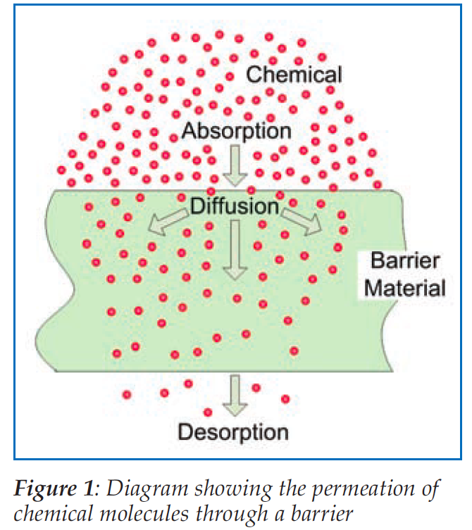
Glove Research

Slide 41
A. Shaw and C. Meekel Research
UMDES & NIOSH
Glove Materials
Polyethelene
Polyvinyl chloride (PVC)
Natural rubber
Neoprene
Nitrile
Butyl
Laminated film
Viton
Glove Thicknesses
0.03
1, 2.5, 2.7, 3, 5, 7, 9, 10
12, 13, 14, 15, 16, 17, 18
20, 21, 23, 25, 28
30, 32
40, 46
Glove Brands
several

Slide 42
Anticipated Results
Spring 2013
  Prepare publication
  Share with EU
  collaborators
  Share with industry and EPA
Beyond Spring
  Consider label language changes
  Conversations with glove manufacturers to discuss labeling of gloves (done in EU)

Slide 43
Goal of Global Effort
– driven by Dr. Anugrah Shaw, NASDARF Consultant
– anugrahshaw@hotmail.com
Simplified, more efficient system for garments and gloves
Standardized terminology based on international standards
Use scenario-based exposure studies – not geographical (country)
Consistent terminology based on performance standards for exposure studies
Pictograms or text to convey clear, concise instructions on what PPE is required
Clothing care instructions on clothing

Slide 44

PPE Risk Assessment/Operator Protection
Symposium
Oct. 21-23,
2013
Host: Phytopathological Institute, Greece
Symposium Chairs: Anugrah Shaw and Kiki Machera
Notes:
DRAFT
· Group 1 – Global consortium - Opportunities and challenges
· Group 2a – Risk assessment strategies – setting of reference values
· Group 2b – Risk assessment strategies – exposure estimation (models, assessment and protection factors)
· Group 3a – Scenario–based operator exposure database
· Group 4b – Harmonization of new exposure initiatives
· Group 4 – PPE requirements and pesticide product labeling

Slide 45

Planning Committee
Kiki Machera, Greece
Anugrah Shaw
Univ. MD Eastern Shore
Kevin Keaney, EPA
Carol Black, NASDARF
Hans Felber, ECPA
Representative, EFSA
Ana Carolina ANDEF
Hamilton Ramos, IAC
Jeff Evans, EPA

Slide 46



PPE and LABELING – PPE Requirements
United States
European Union
Brazil
Protective Clothing
Protective Clothing
Protective Clothing
Levels of protection based primarily on garment type and layers.
  Requirements from lowest to highest protection are: Long-sleeved shirt and long pants; Coveralls over short-sleeved shirt and short pants; Coveralls over long-sleeved shirt and long pants; Chemical- resistant suit.
No certification required for garments.
Adoption of ASTM/ISO standards with three levels of performance is being discussed.
The PPP Directive requires that product labeling include protective clothing requirements. Statements included in the Annex are very general.
  Protective clothing sold in EU must comply with European Directive 89/686/EEC and must be certified.
    Certified Type 6 and Type 4 chemical protective clothing are typically used to increase protection factor.
    DIN 32781 is used in Germany to assess only one level for protective clothing in agriculture.
    Currently, an EN or ISO/EN standard for PPE for pesticide operators is being discussed in CEN.
Divergent approaches for the two directives create problems in communicating requirements.
Certified protective clothing is required in Brazil.
The garments must meet ISO 27065 Level 2 or Level 3 requirements.
The law allows the use of garments that have been certified in accordance with Level 2 or Level 3. There is no differentiation in the requirements based on level of protection.
Regular work clothing cannot be worn while applying pesticide in Brazil.
Chemical Resistant Gloves
Chemical Resistant Gloves
Chemical Resistant Gloves
No gloves is the lowest level of hand protection.
EPA Chemical Resistance Category Selection Chart which consists of eight categories, eight types of materials , and four levels of protection – none, slight, moderate and high is used for glove selection.
The chart is based on material and breakthrough time of the solvent against which the material was tested. No certification required.
The type of gloves to be worn, including the type of material and the breakthrough time of the glove material, must be specified.
Information is specified in accordance with EN 374: 2003. Breakthrough time is typically reported for solvents.
Chemical resistant gloves are required for all products.
No certification is required.

Slide 47

PPE AND LABELING – Information on Pesticide/Plant Protection Product Label
United States
European Union
Brazil
Label Information
Label Information
Label Information
Worker Protection Standard (WPS) says PPE requirements must be stated on all products.
  Garment – Description for protective clothing is used consistently. One of the following terms is seen on labels. Long-sleeved shirt and long pants; Coveralls over short-sleeved shirt and short pants; Coveralls over long-sleeved shirt and long pants; Chemical- resistant suit. If needed, more than one requirement is included on the label based on exposure scenario or type of activity.
  Gloves – Descriptions used for gloves vary considerably. Terms such as waterproof and chemical resistant are used interchangeably.
  Additional dermal toxicity and/or skin irritation PPE for toxicity category I or II
    Chemical-resistant headgear for overhead exposure
    Chemical-resistant apron for mixing and loading
Very general precautionary statements that are part of the Globally Harmonized System of Classification and Labelling of Chemicals (GHS) are used. Given below are the phrases for PPE.
P280 - Wear protective gloves/protective clothing/eye protection/face protection (manufacturer/supplier of PPP to specify type of equipment).
P281 - Use personal protective equipment as required (no details are provided)
P284 - Wear respiratory protection (manufacturer/supplier of PPP is to specify type of equipment)
Given below are examples of specifications provided by manufacturer of PPP:
Use suitable, appropriate or adequate protective clothing
Use air impermeable clothing
Pictograms used for mixing and loading and application.
According to the pictograms on pesticide product labels, all products require the use of protective clothing, gloves, etc.
Bottom Line: Language on labels and in labeling guideline documents needs to be specific and clear. A performance-based process that provides levels of protection would clarify the labeling process and improve communication to users.

Slide 48
RECOMMENDATIONS
International Performance Based Standards
  Use ISO 27065 and equivalent standards as basis to define protective clothing. All clothing will be referred to as level 1, 2, or 3.
  Develop performance requirements for gloves.
Risk Assessment
  Assign level to garments worn in existing exposure studies.
  Collaborate to conduct future exposure studies to fill gaps.
  Assign protection factors for each level of clothing and gloves.
Use levels based on performance of PPE to define requirements.
Ensure availability of garments and gloves for the levels required.

Slide 49
SUMMARY: Use International Performance Standards as a Basis for Standardizing the Risk Assessment, Requirements, and Labeling
Use of a simplified, more efficient system of garment labeling
→Levels 1, 2, and 3, which can be clearly understood by the industry, regulatory groups, trainers, and users.
Use of standardized terminology based on international performance-based standards provides a framework for global communication; individuals from different countries can speak and understand the same PPE language.
Standard terminology helps connect the dots; the process is more systematic.

Slide 50
SUMMARY: Use International Performance Standards as a Basis for Standardizing the Risk Assessment, Requirements, and Labeling
Use of a scenario-based approach allows a mechanism for the global community to work together to ensure that the data is robust enough for all scenarios , mechanized as well as handheld. It allows countries that currently do not have models applicable for scenarios representative for their countries to work with others to fill in the gaps.
Assigning levels to garments worn in existing exposure studies may help in harmonizing existing models. It also helps in identifying gaps.

Slide 51
SUMMARY: Use International Performance Standards as a Basis for Standardizing the Risk Assessment, Requirements, and Labeling
Use of pictograms or text to convey clear and concise information that is easy to understand will assist in effectively communicating the requirements based on risk mitigation.
Information for care, use, and maintenance is required to be stated on the PPE as part of the international PPE performance specification standard. Therefore, issues of care will be addressed by standards, and they do not have to be included on the pesticide product label.

Slide 52

Bottom line
Greater the harmonization, easier for label consistency and risk mitigation
Minimum requirements provide a mechanism to balance protections with comfort
Certified garments and gloves can be referenced on pesticide labels

Slide 53
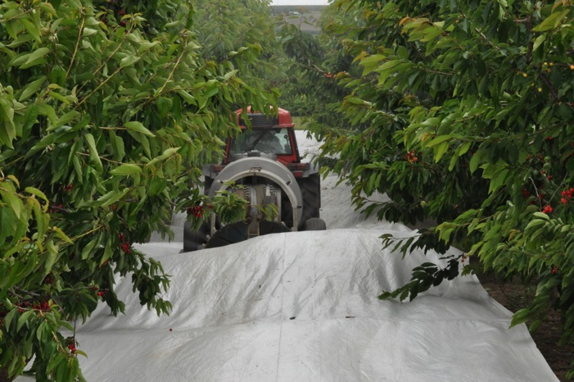



arol
Questions
Carol Black, NASDA Research Foundation & Washington State University
2013 Pesticide Stewardship Alliance Conference
Notes:
11 images

